Slide 1

Analysis and Visualization of
Indian Agriculture Crop Statistics
Project Guide: Deepak Rao
Members:
Carol Dcunha 171046001
Sushmitha Shetty 171046037

Slide 2
Contents
Introduction
Objective
Design
Specific Requirements
Challenges
Results
Future Work
Conclusion

Slide 3
Introduction
Indian economy is heavily dependent on Agriculture and Horticulture
Affected by various factors like lack of knowledge of crops, land, cost
Limited usage of modern technologies
Big Data techniques provide effecient ways to understand data
Make effecient analytical decisions

Slide 4
Objective
Analyze agriculture data like yield, land utilization, area and production of principal crops
Analyze area and production of horticulture data
Visualize the given data to infer relationships

Slide 5
Specific Requirements
Hardware Specifications
  64-bit machine
  RAM: 2GB or above
  Hard Disk: 1GB
  Processor: Intel core i5/i7
Software Specifications
  Python 2
  Numpy
  Pandas
  Matplotlib
  Basemap

Slide 6
Design
Data Collection
  Ministry of Statistics and Programme Implementation, http://www.mospi.gov.in/
  Agriculture data - area, production, yield, land utilization
  Horticulture data - area, production

Slide 7
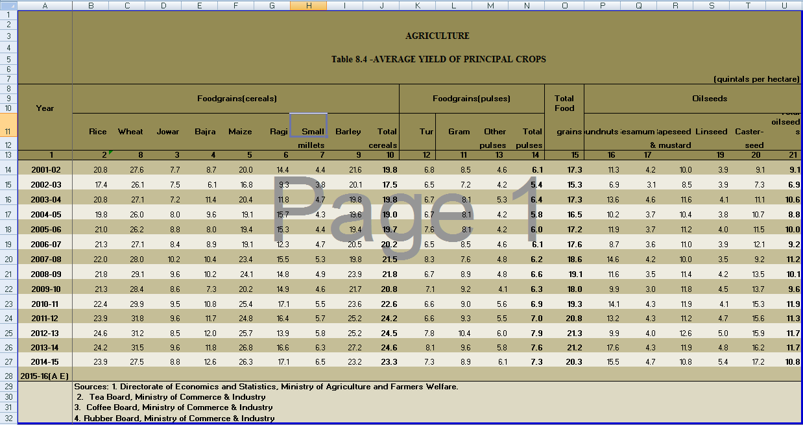
Design

Slide 8
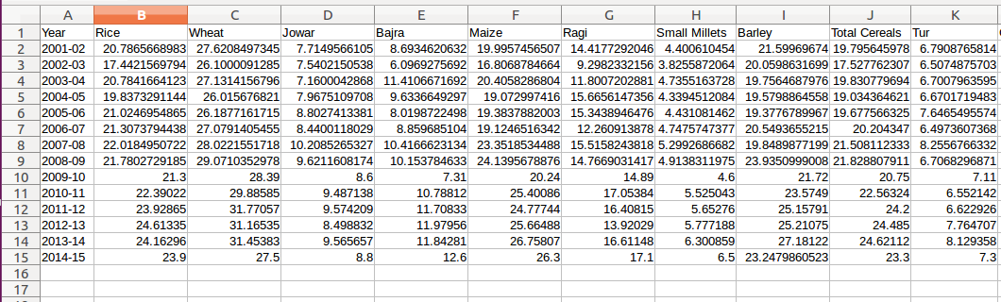
Design
Data Cleaning
  Data obtained is semi-structured
  Automated extraction of relevant fields into structured .csv files using python and pandas

Slide 9
Design
Data Analysis and Visualization
  Plotted charts/maps of yield versus area, production and land utilization
  Used matplotlib with python
  Basemap provided geographical map of India
  Inferred relationships by observing trends

Slide 10
Challenges
Cleaning data
Obtaining shapefile for India and plotting Basemap

Slide 11
Result
Observed partial relationship of yield’s dependence on area and production for agriculture data
Observed relationship between area and production for horticulture data

Slide 12
Future Work
Obtaining other factors that play role such as irrigation techniques, soil quality, weather forecast and production costs
Predicting the yield as an outcome from all the affecting factors

Slide 13
Conclusion
Analysis and prediction of agriculture and horticulture data can be used by government organizations to understand trends and take appropriate decision, thereby improving the Indian economy

Slide 14
Thank You

